Slide 1
5.5-5.8 Advanced Security
PART II
brought to you by clem, ceo of subway

Slide 2
5.5 GPEDIT in Depth

Slide 3
GPEDIT Categories
Computer Configuration
User Configuration

Slide 4
GPEDIT Subcategories
Software Settings
Not a big concern
Windows Settings
Includes LSP, firewall, startup/shutdown scripts
Administrative Templates
The restrictive settings you all know and love

Slide 5
GPEDIT Administrative Templates Sub-subcategories
Control Panel
Network
Printers
Server
Start Menu and Taskbar
System
Windows Components

Slide 6
Sub sub categories in depth
Control Panel
Lock screen settings
Language and input
Other non important ones
Network
A bunch of network related settings
Important considerations include:
DNS
Network Connections (Firewall)
Printers
Printer settings
Server
Some backup settings

Slide 7
Sub sub categories in depth (cont.)
Start Menu and Taskbar
Start Menu and a tiny Notifications setting
Not really important
System
More interesting settings
Important considerations include:
Logon
Remote Assistance
Windows Components
Majority of security settings here
Recommended to check each subcategory for yourself
There’s BitLocker, Internet Explorer, Windows Update, and much more

Slide 8
5.6 BitLocker

Slide 9
What is BitLocker?
Encrypts your hard drive
Set up requires a Trusted Platform Module
Since not provided in VMs, you’ll have to set a setting in GPEDIT to ignore that
Server versions require you to install the feature first

Slide 10
Where is the GPEDIT setting?
Windows Components > BitLocker Drive Encryption > Operating System Drives > Require additional authentication at startup
Enable it and check the “Allow BitLocker without a compatible TPM”

Slide 11
How to set up?
Windows search for BitLocker
You’ll need to provide a password or a USB to gain access to the drive, and you’ll be asked to set up a recovery key - use a USB or “fake print”
DO NOT MESS UP HERE!!! You may accidentally lock yourself out of your computer if you don’t have the password/USB you used.

Slide 12
BitLocker setup
BitLocker will do its magic
After a while, you may be asked to restart to make changes
When restarting, you’ll be greeted with a blue prompt if you chose the password route
Afterwards, you can log in to the computer normally

Slide 13
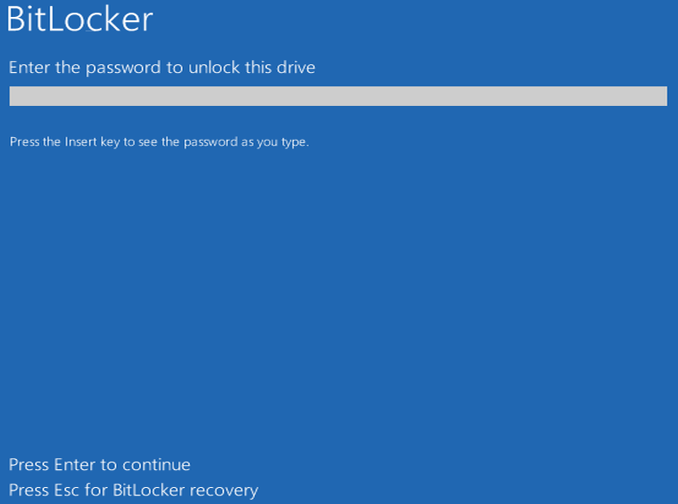

Slide 14
5.7 Program Security

Slide 15
Programs have their individual security settings
Each program may come equipped with security settings that you can set to improve security

Slide 16
Exploration Adventure
Most of the time, these settings are found by your own exploration.
Settings are generally found under Edit > Preferences - can vary
Google for the right place for settings

Slide 17
Online research alternative
Many commonly used programs will have forums or some documentation outlining secure settings
Take advantage of these sites!
Ex: Google “Filezilla hardening”

Slide 18
5.8 Network Security

Slide 19
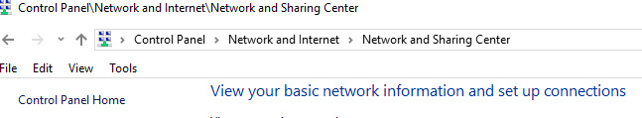
Network and Sharing Center

Slide 20
What is found here?
Network settings - WiFi, access type, connection method
You can change adapter settings and advanced settings

Slide 21
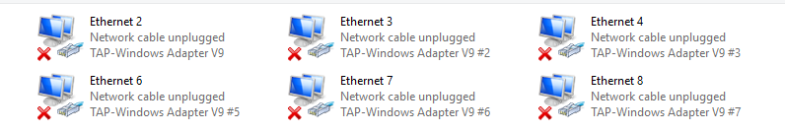
Adapter settings

Slide 22
Adapters
You can configure which adapters are enabled/disabled for Internet connections
Checking the properties of an adapter will allow you to set settings for that

Slide 23
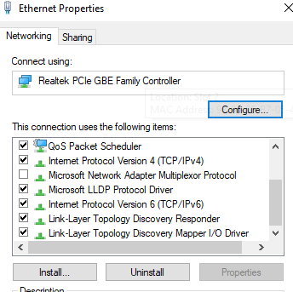
Adapter settings

Slide 24
What to do?
Install/uninstall connection items
If you are unsure about this, it’s better to not screw up your connection
Manage properties of connections

Slide 25
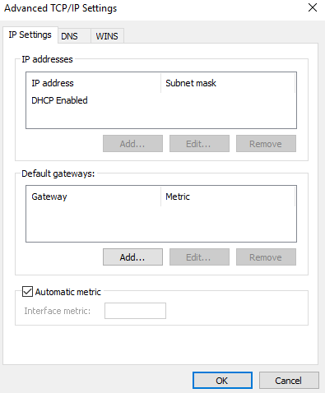
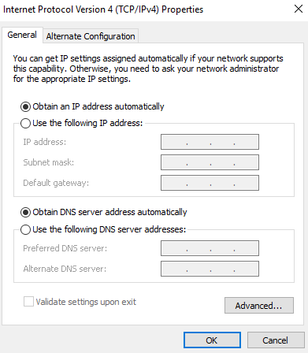
IPv4 Properties

Slide 26
What is this for?
If you ever need to double-check or set IP addresses or DNS server addresses, here is where you go to

Slide 27
Advanced sharing settings
For each profile, configure the option that makes the most sense
Most of these are common sense, don’t worry

Slide 28
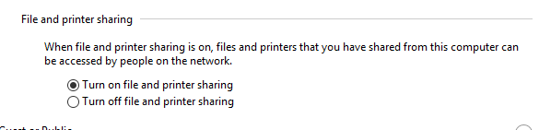
Assuming no files are to be shared, is this setting correct?

Slide 29
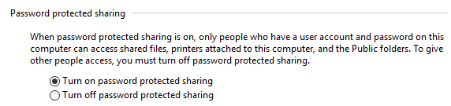
To have a password or not to have one…?

Slide 30
There are a few other settings
Some settings even provide you the recommended choice
Simple configuration, no wacky settings here

Slide 31
End of Part II

